Slide 1


PROGRAMMATION WEB
Web application for online store
Master 2
Réalisés par :
Fuat KARA
Sous la supervision de Madame :
Sovanna TAN
2022-2023

Slide 2








Used Technologies
=>

Slide 3
Functionalities
-Adding to Cart
-Purchase Transactions
-Registering
-Login and Log Out
-Deleting the product from Cart
-Ordering the product by Card or Cash
-Changing the status of the order by Admin

Slide 4

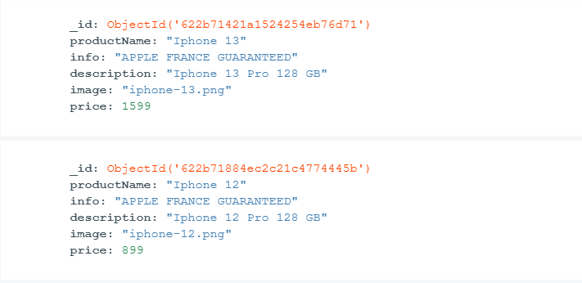
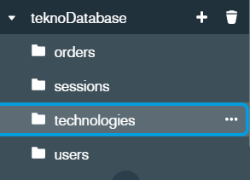
Database
(MongoDB)

Slide 5
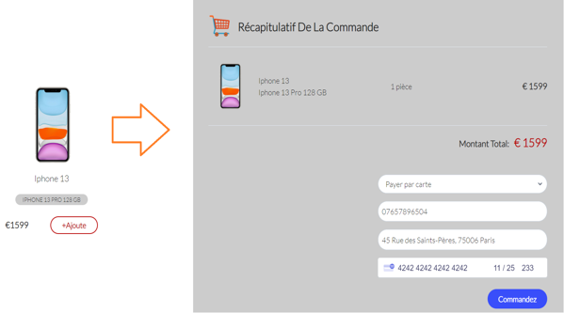
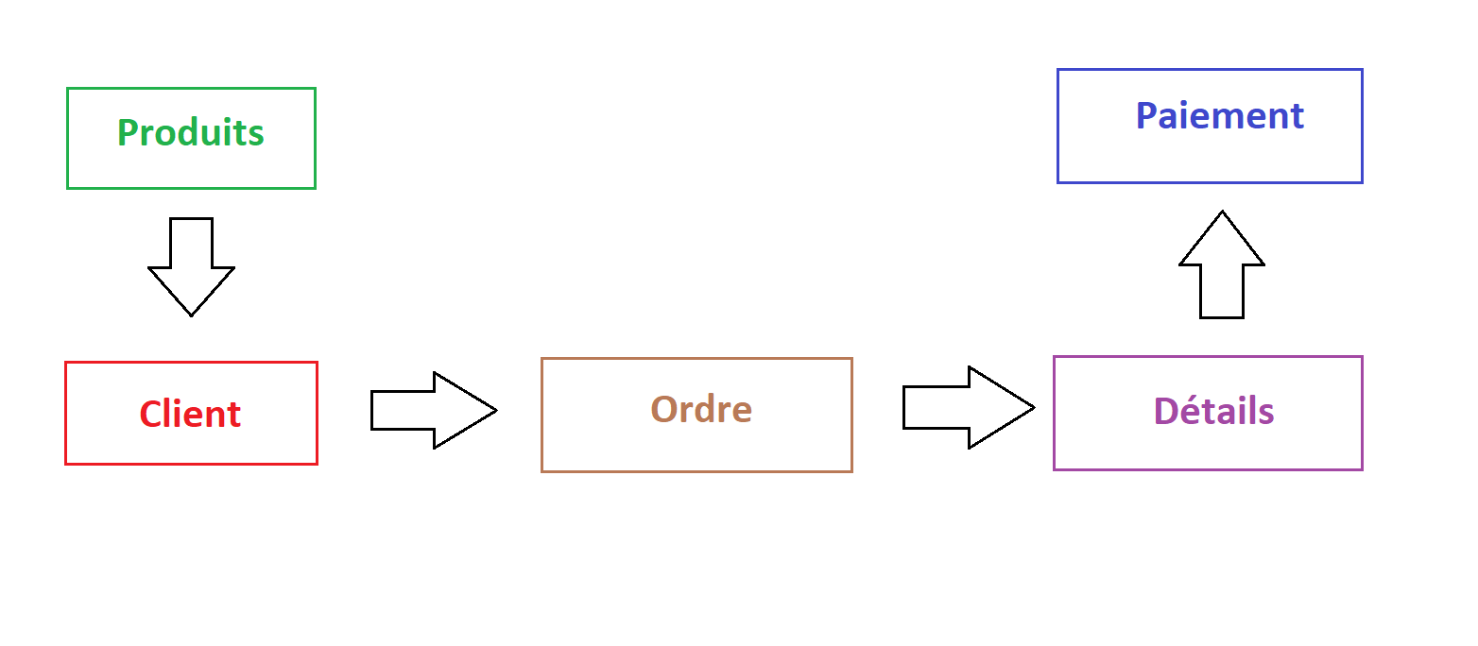
System operation

Slide 6
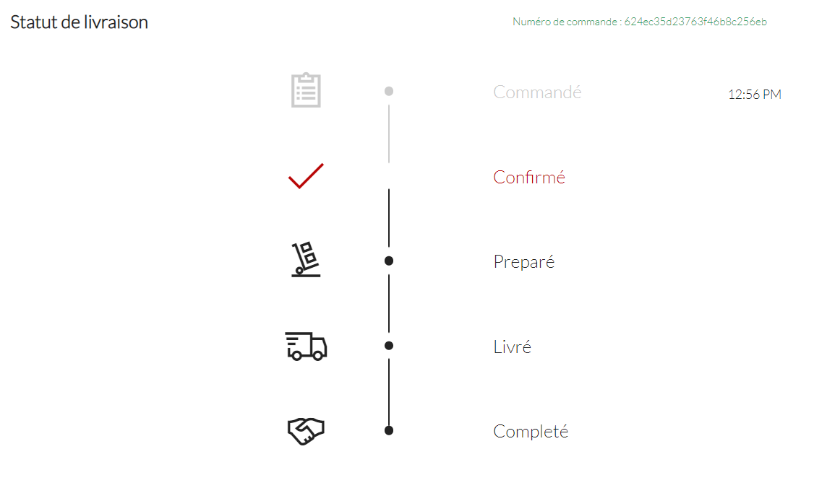
Delivery Status

Slide 7
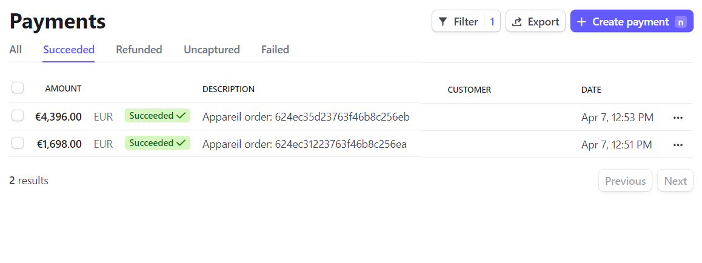
Connecting to other API
(Stripe)

Slide 8
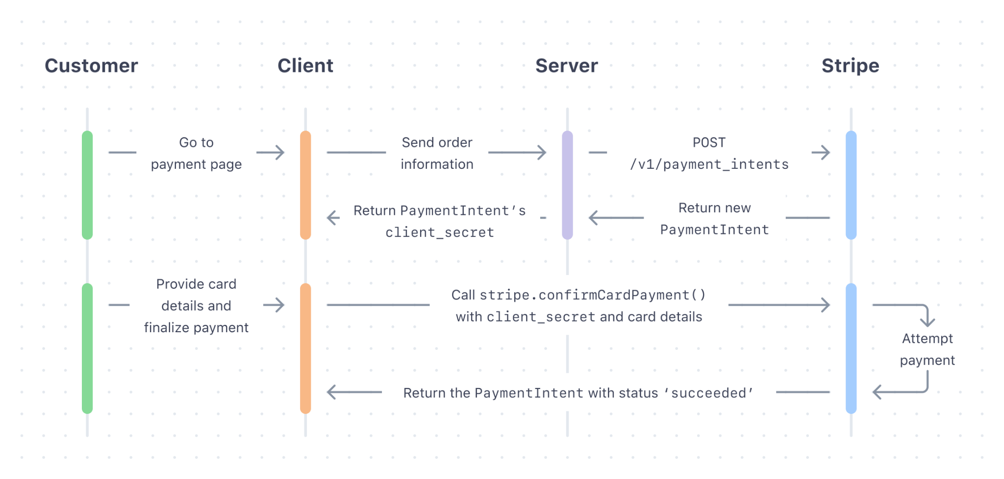
How the payment method works
(Stripe)

Slide 9
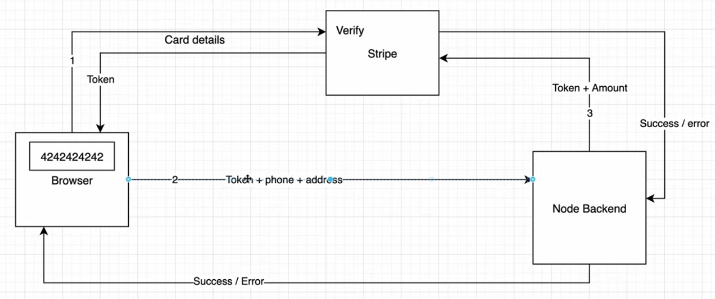
How the payment method works
(Stripe)

Slide 10
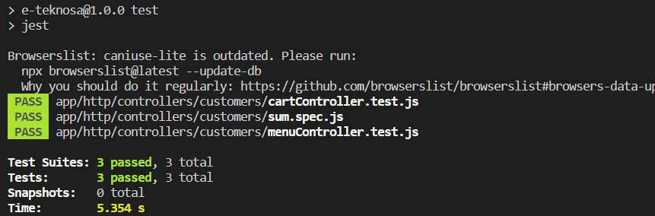
Unit Testing with Jest JS

Slide 11
Project’s Link
Github: github.com/BalamiRR

Slide 12
Thank you

